Slide 1


Data Translation of Zomato Restaurants Data to MySQL
By Robin Sah (G48297336)
4/29/2024
Instructor:
Joel Klein

Slide 2
Zomato Restaurants Data
Loads of data for Data Analyst
About Zomato
Zomato has 80 million monthly active users as of March 2023, primarily targeting the 18-35-year-old demographic.
Zomato lists 1.4 million restaurants on its platform.
The platform receives an average of 1.2 million orders daily.
It operates in 24 countries and is present in over 3,200 cities worldwide.
Zomato’s revenue in Dec 2022: 1,948 crores (The revenue rose 75% to Rs 1,948 crore from Rs 1,112 crore in Q3FY22)
Zomato is an Indian multinational restaurant aggregator and food delivery company founded in 2008.
Zomato provides information, menus and user-reviews of restaurants as well as food delivery options from partner restaurants in select cities.
Analysts can use these data to understand eating patterns, pricing strategies, and demographic trends, helping restaurants tailor their offerings and marketing strategies effectively.
perform comparative market analyses
forecast industry trends.

Slide 3
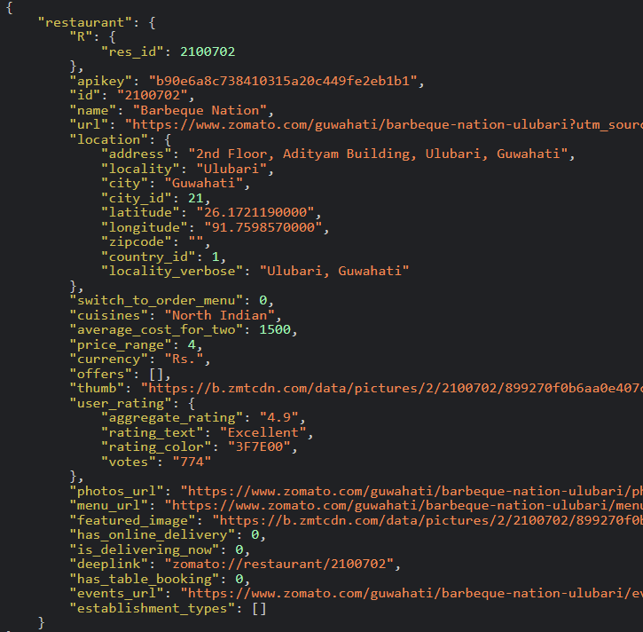
About Dataset
Data has been collected from the Zomato API in the form of .json files(raw data).
URL=https://www.kaggle.com/shrutimehta/zomato-restaurants-data
There are 5 json files available.
3 json files combined together is used for this translation project
A snippet of restaurant object

Slide 4


Steps Involved in Carrying out the Data Translation
Data Exploration and Cleaning: identify inconsistencies, missing values, and potential transformations needed (Jupyter Notebook)
Data Transformation: use python scripts to transform the JSON dataset into a format that can be viewed and analysed clearly, normalizing nested structures, and preparing CSV files for import into MySQL (Jupyter Notebook)
Database Setup and Data Import: import the transformed data generated as .csv files to MySQL (MySQL Workbench)
Database Schema Design: design a normalized database schema that efficiently represents the data, paying attention to entities like restaurants, cuisines, and locations, and their relationships (MySQL Workbench)
Analysis and Reporting: to perform various analyses to uncover insights related to restaurant ratings, popular cuisines by region, price trends and more (Jupyter Notebook)

Slide 5
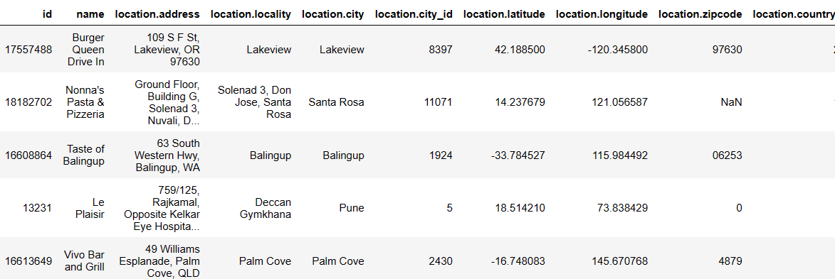
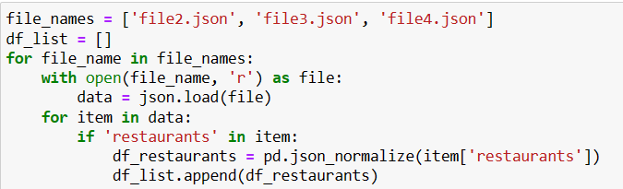
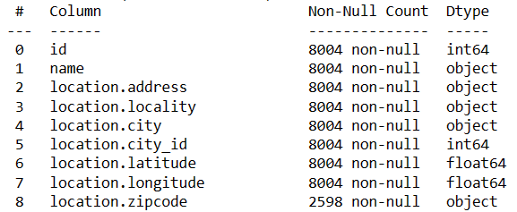
Data Exploration
- python scripts leveraged for importing and combining .json files
- contains 28151 rows with 100s of same data repeating
Cleaning
- Removing all the duplicate rows and unwanted columns

Slide 6
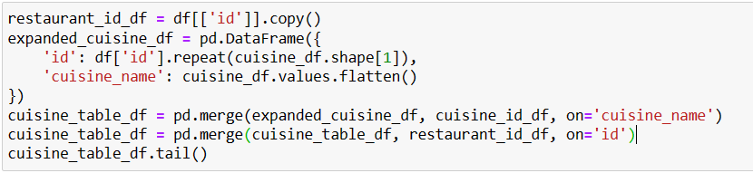
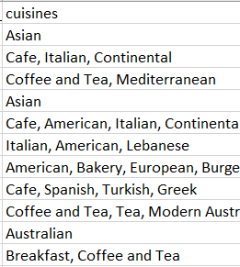
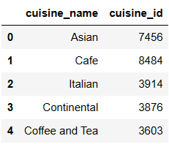
Normalization and exporting .csv files
In Jupyter Notebook, manually examining the data frame's structure and identifying any repeating groups, partial dependencies, or transitive dependencies, and then applying normalization rules to eliminate them, resulting in a more efficient and robust database schema.
- Main data frame not even in 1NF due to multiple values in cuisines column
- Each cuisine name stored in separate row with unique cuisine_id
- Similarly, made .csv files for different data frames – cuisine, rating, services, location, country, and restaurant

Slide 7
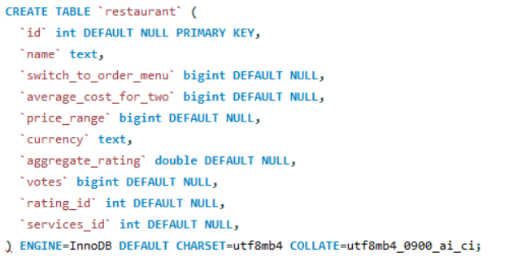
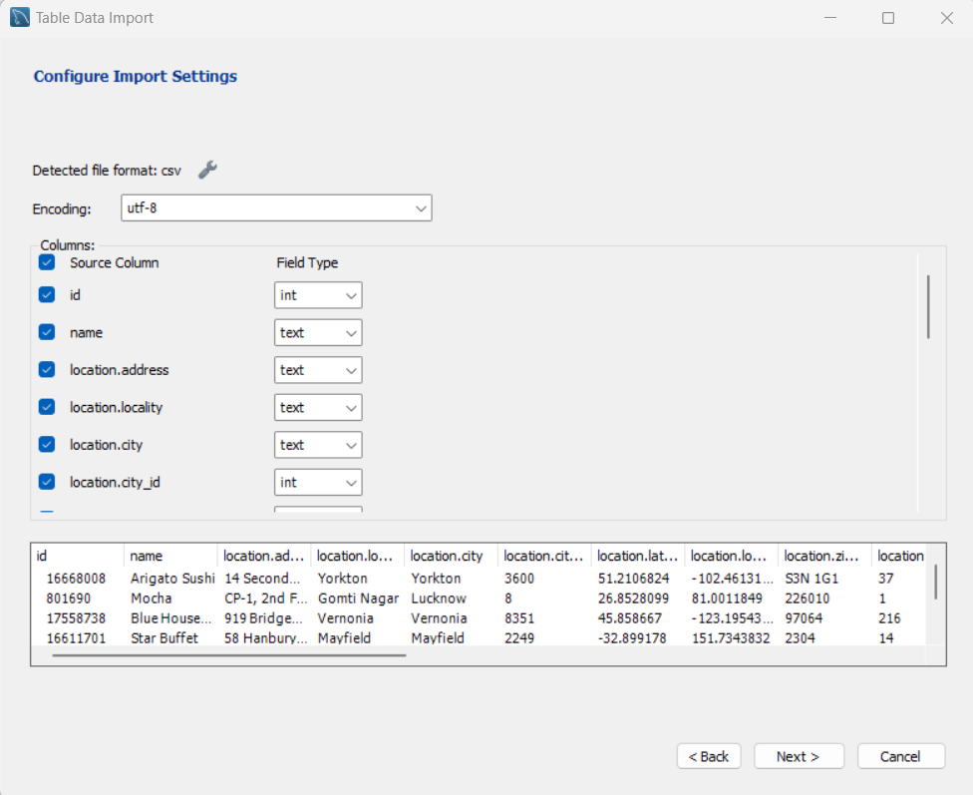
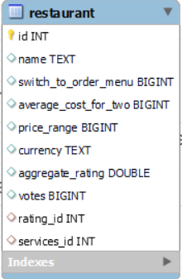
Importing .csv files to MySQL Workbench
- Importing csv files to MySQL Workbench to create tables
- Created restaurant table with proper primary key and foreign keys

Slide 8
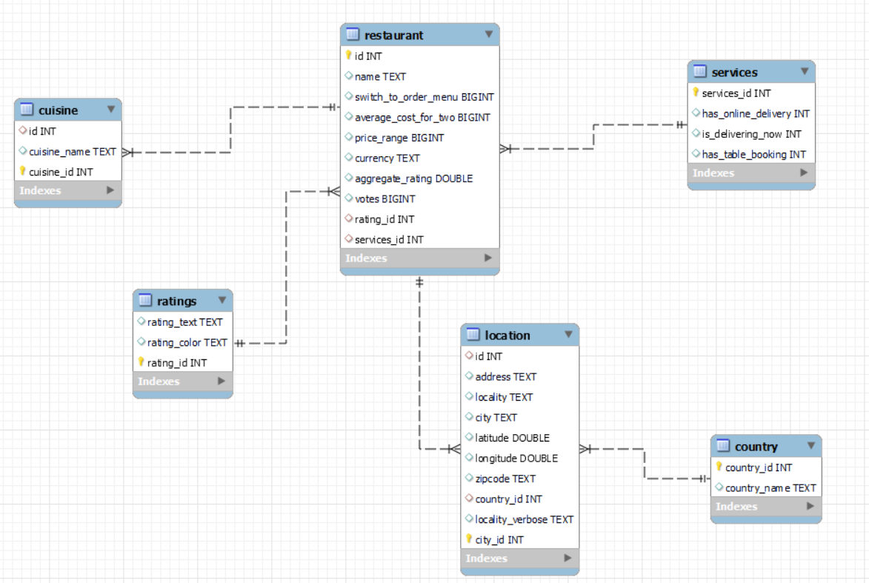
ER Diagram
Tables info:
A total of 6 tables created after normalizing
Restaurant
Cuisine
Ratings
Services
Location
country
All tables assigned with primary key and foreign key if necessary
Relationships:
Restaurant and cuisine : 1 : m
Restaurant and ratings : m : 1
Restaurant and location: m : 1
country and location(city): 1 : m

Slide 9
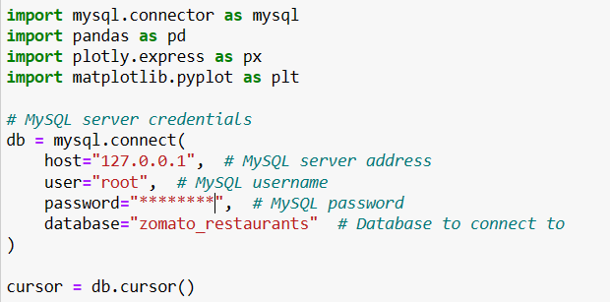
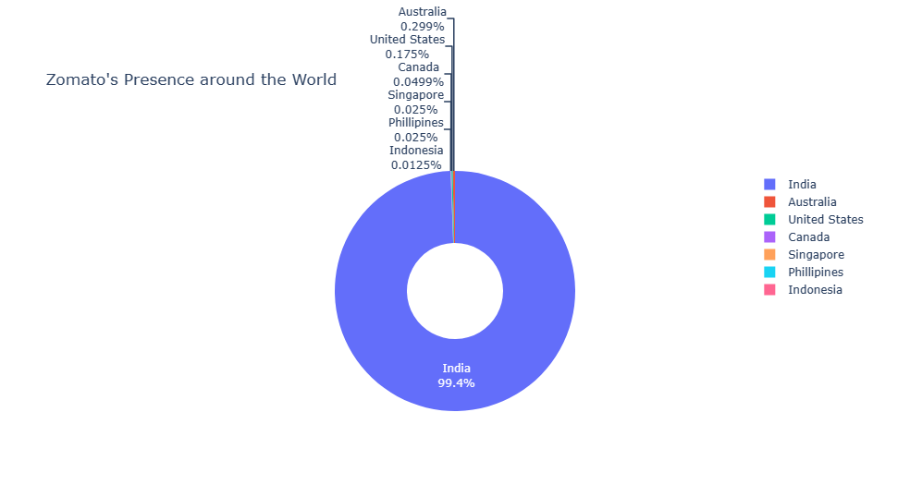
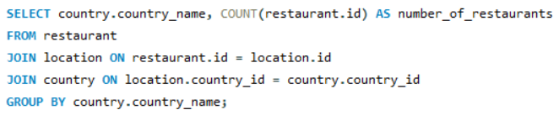
Analysis and Visualization(Jupyter Notebook)
- Setting up connection with MySQL Workbench
Get the count of restaurants per country
Suggesting that Zomato is a startup from India, so it has maximum business spread across restaurants in India

Slide 10
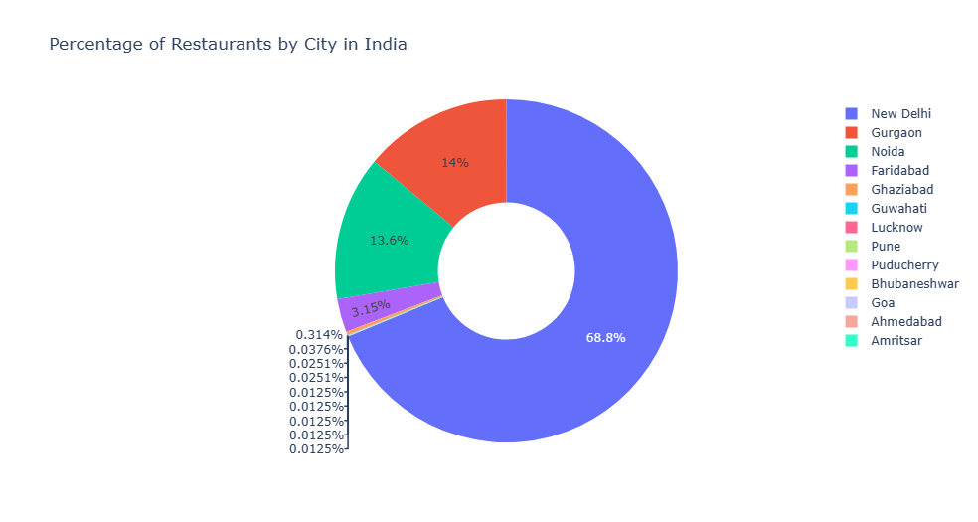
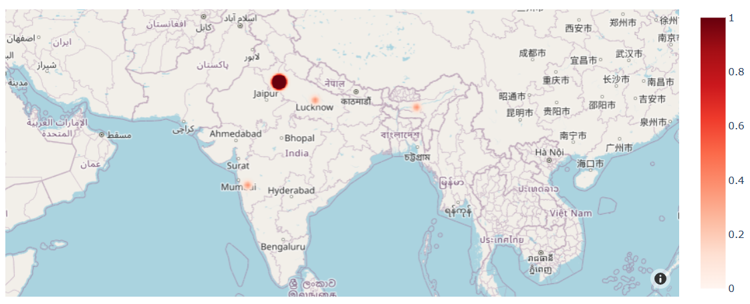
Get the count of restaurants per city in India
The capital has the most number of restaurants listed on the platform.
View the area with most restaurants with high rating

Slide 11

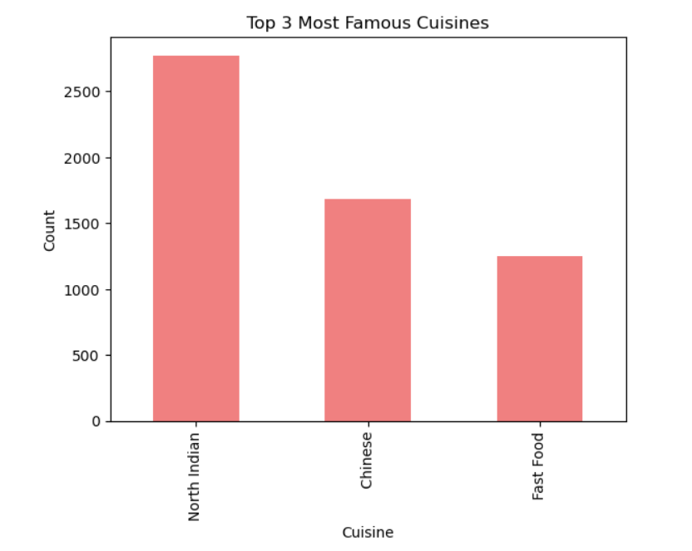

Get the price range and aggregate rating
Suggesting that usually the restaurants with high rating are expensive.
Correlation between `aggregate_rating` and `average_cost_for_two`
Find the top 3 most famous cuisines with counts and percentages

Slide 12
Inferences and Conclusions
We’ve drawn many inferences from the survey. Here’s a few of them:
The dataset is skewed towards India and doesn’t represent the complete data of restaurants worldwide.
Some of the best-rated restaurants are low on cost and vice versa.
High number of columns present in the main table so, normalization process is difficult and depends on the schema designer.
This data translation project has helped in learning synergy between data processing, database management, and data analysis techniques. By importing JSON formatted data into a Jupyter Notebook, we successfully navigated the complexities of data cleaning and transformation, adapting raw data into a structured format suitable for analytical purposes. This step was crucial in ensuring data integrity and usability, highlighting the importance of preliminary data processing in any data-centric task.

Slide 13
Thank you

